Slide 1
METHODS OR FUNCTIONS IN C#

Slide 2
METHODS OR FUNCTIONS
A method is a group of statements that together perform a task.
Methods are functions declared in a class and may be used to perform operations on class variables.
They are blocks of code that can take parameters and may or may not return a value.
It is used to perform specific task.
Methods are reusable.
Every C# program has at least one class with a method named Main.

Slide 3
METHODS OR FUNCTIONS
Conventions to be followed for naming methods state that a method name:
The following syntax is used to create a method:
Cannot be a C# keyword, cannot contain spaces, and cannot begin with a digit Can begin with a letter, underscore, or the “@” character
Some examples of valid method names are: Add(), Sum_Add(), and @Add().

Slide 4
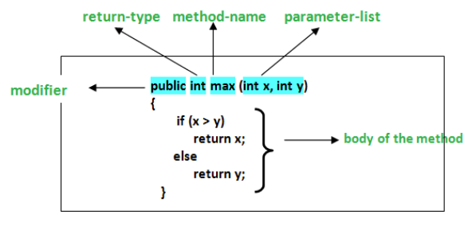
Defining Methods in C#
The syntax for defining a method in C# is as follows −

Slide 5
Defining Methods in C#
The syntax for defining a method in C# is as follows −
<Access Specifier> <Return Type> <Method Name>(Parameter List) {
Method Body
}

Slide 6
Invoking Methods
To use a method, you need to −
Define the method
Call the method
A method can be invoked in a class by creating an object of the class where the object name is followed by a period (.) and the name of the method followed by parentheses.
In C#, a method is always invoked from another method.
This is referred to as the calling method and the invoked method is referred to as the called method

Slide 7
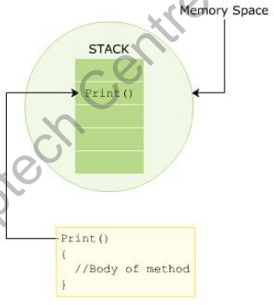
Invoking Methods
The following figure displays how a method invocation or call is stored in the stack in memory and how a method body is defined

Slide 8
METHODS OR FUNCTIONS
Method Parameters and Arguments
Parameters: The variables included in a method definition are called parameters.
Which may have zero or more parameters, enclosed in parentheses and separated by commas.
If the method takes no parameters, it is indicated by empty parentheses.
Arguments:
When the method is called, the data that you send into the Arguments method's parameters are called arguments

Slide 9
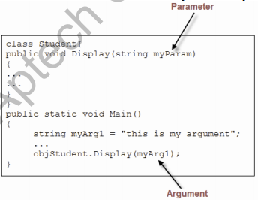
METHODS OR FUNCTIONS
Method Parameters and Arguments

Slide 10
METHODS
There are 2 types of methods.
1. Static methods
2. Non-Static / Instance methods

Slide 11
METHODS
According to parameters there are 2 types of methods.
1. Parameterized methods
2. Non-Parameterized methods

Slide 12
Named and Optional Arguments
A method in a C# program can accept multiple arguments that are passed based on the position of the parameters in the method signature.
A method caller can explicitly name one or more arguments being passed to the method instead of passing the arguments based on their position.
An argument passed by its name instead of its position is called a named argument.

Slide 13
Named and Optional Arguments
While passing named arguments, the order of the arguments declared in the method does not matter.
Named arguments are beneficial because you do not have to remember the exact order of parameters in the parameter list of methods.

Slide 14
return keyword in C#
The return statement is used to return value.
When a program calls a function, the program control is transferred to the called function.

Slide 15
Advantages of using the Methods :
There are many advantages of using methods. Some of them are listed below:
It makes the program well structured.
Methods enhance the readability of the code.
It provides an effective way for the user to reuse the existing code.
It optimizes the execution time and memory space.

Slide 16
PARAMS KEYWORD IN C#

Slide 17
C# Params
Params is an important keyword in C#. It is used as a parameter which can take the variable number of arguments.

Slide 18
C# Params
Important Point About Params Keyword :
It is useful when programmer don’t have any prior knowledge about the number of parameters to be used.
Only one Params keyword is allowed and no additional Params will be allowed in function declaration after a params keyword.
The length of params will be zero if no arguments will be passed.

